Slide 1
COMPARISION OF CLASSIFIER FOR PREDICTING BREAST CANCER USE IN ORANGE
Presented By:
Debadrita Saha
Mtech 3rd Sem
Roll No-90/CSE/210006
DEPT of : Computer Science &Engineering

Slide 2
ACKNOWLEDGEMENT
I, sincerely thank “Dr Anirban Mukhopadhyay” sir for his guidance and giving me this opportunity to do this seminar.

Slide 3
WHY ORANGE?
It is an open source.
Machine learning and data analysis.
Data visualization.
No programming.
Platform independent software.
Allows clustering and classification.
Data mining through visual programming and python scripting.

Slide 4
DATASET : BREAST CANCER
Has 570 instances
33 attributes
Categorical class with 2 values (M,B)
In .csv format
Source: Kaggle

Slide 5
How following factors cause Breast Cancer?
Tumors can be benign (noncancerous) or malignant (cancerous).
Benign tumors tend to grow slowly and do not spread.
Malignant tumors can grow rapidly, invade and destroy nearby normal tissues, and spread throughout the body.

Slide 6
SELECTED ALGORITHM:
KNN
DECISION TREE
RANDOM FOREST
SVM
NAIVE BAYES

Slide 7
KNN(K NEAREST NEIGHBOR)
K-Nearest Neighbour is one of the simplest Machine Learning algorithms based on Supervised Learning technique.
K-NN algorithm can be used for Regression as well as for Classification .

Slide 8
NAIVE BAYES
It is a probabilistic classifier, which means it predicts on the basis of the probability of an object.
Naive Bayes algorithm is a supervised learning algorithm, which is based on Bayes theorem and used for solving classification problems.

Slide 9
RAMDOM FOREST
Random Forest is a popular machine learning algorithm that belongs to the supervised learning technique.
Random Forest is a classifier that contains a number of decision trees on various subsets of the given dataset and takes the average to improve the predictive accuracy of that dataset.

Slide 10
SVM(Support Vector Machine)
Support Vector Machine or SVM is one of the most popular Supervised Learning algorithms.
The goal of the SVM algorithm is to create the best line or decision boundary that can segregate n-dimensional space into classes so that we can easily put the new data point in the correct category in the future.

Slide 11
DECISION TREE
Decision Tree is a Supervised learning technique that can be used for both classification and Regression problems.
In a Decision tree, there are two nodes, which are the Decision Node and Leaf Node.

Slide 12
CONCLUDING RESULT

Slide 13
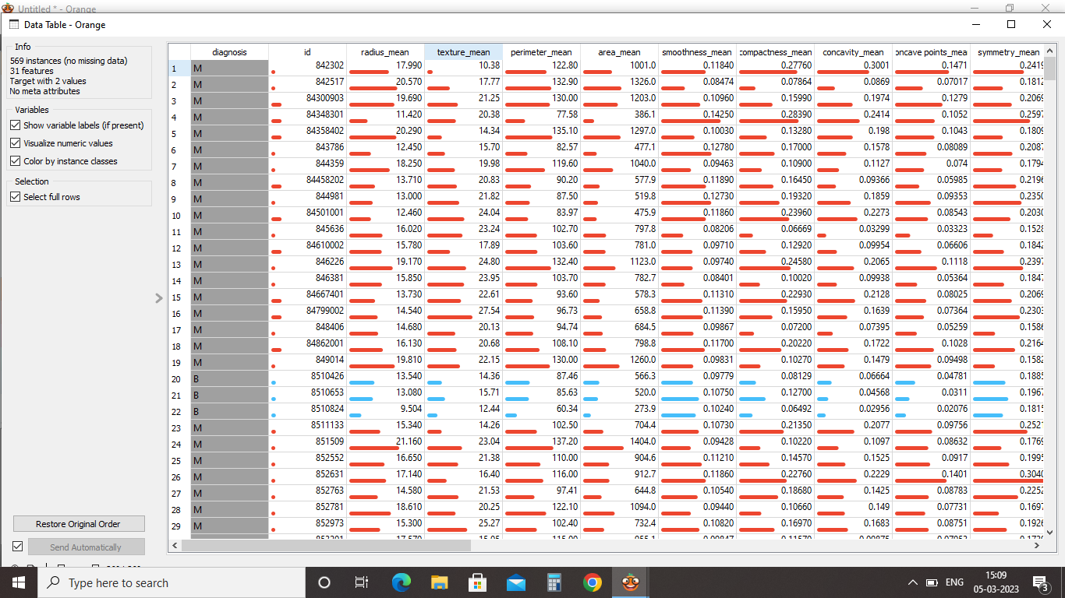

Slide 14
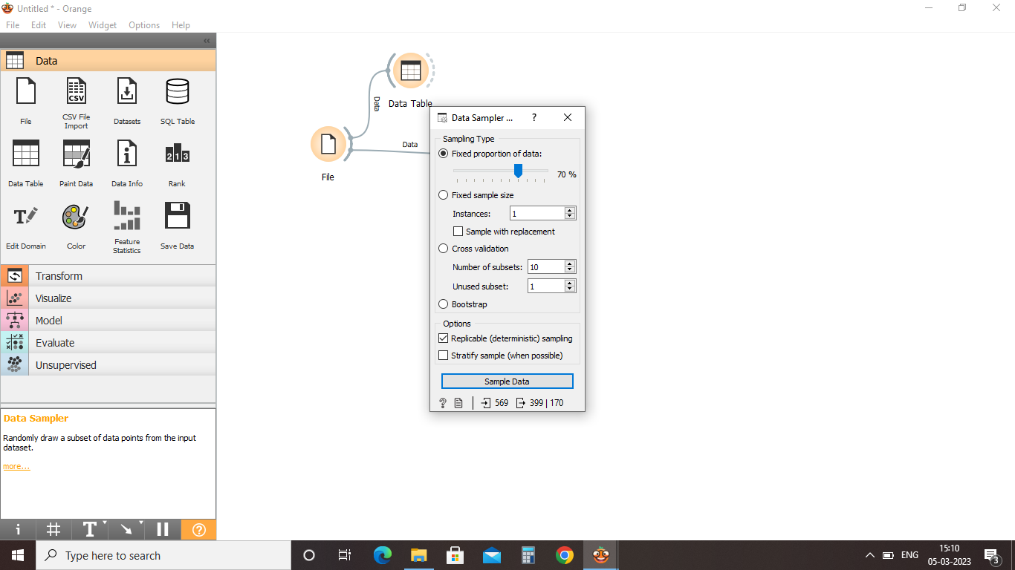

Slide 15
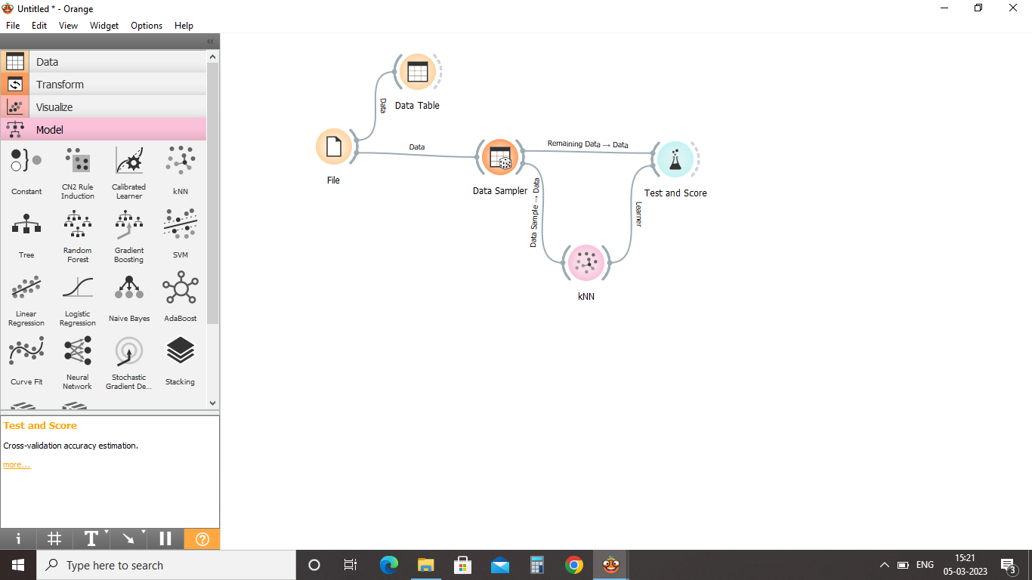

Slide 16
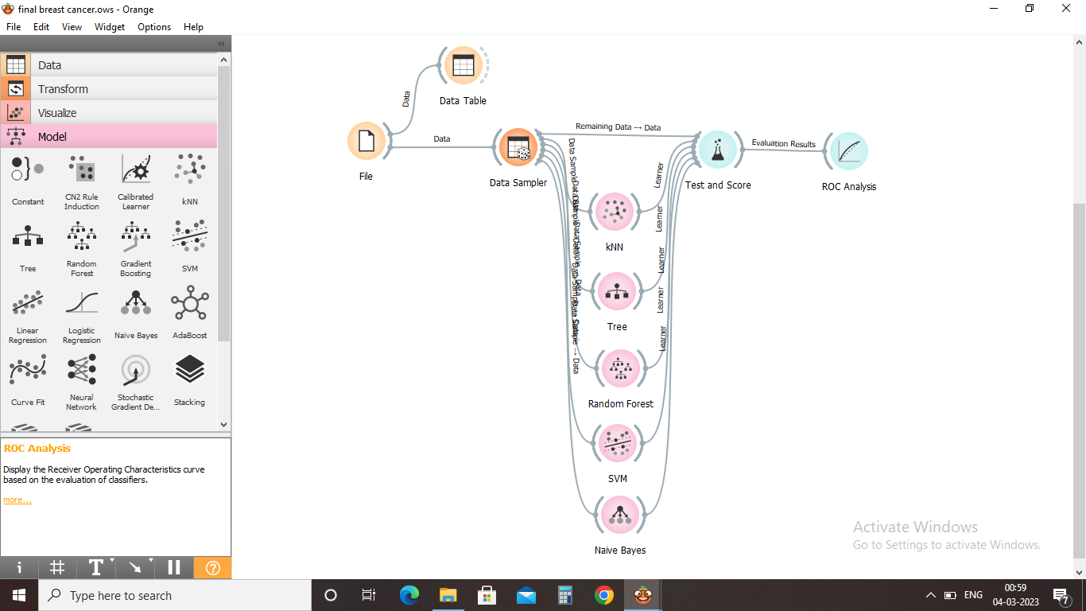

Slide 17
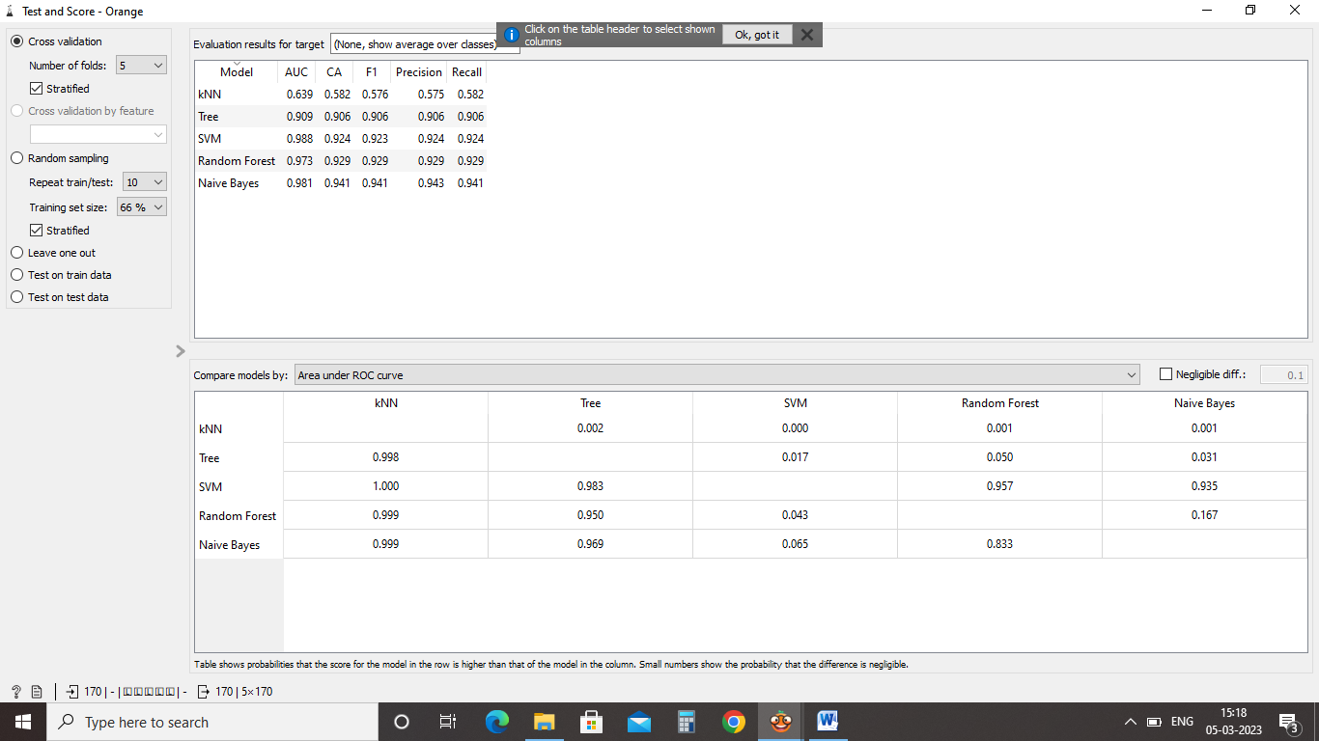

Slide 18
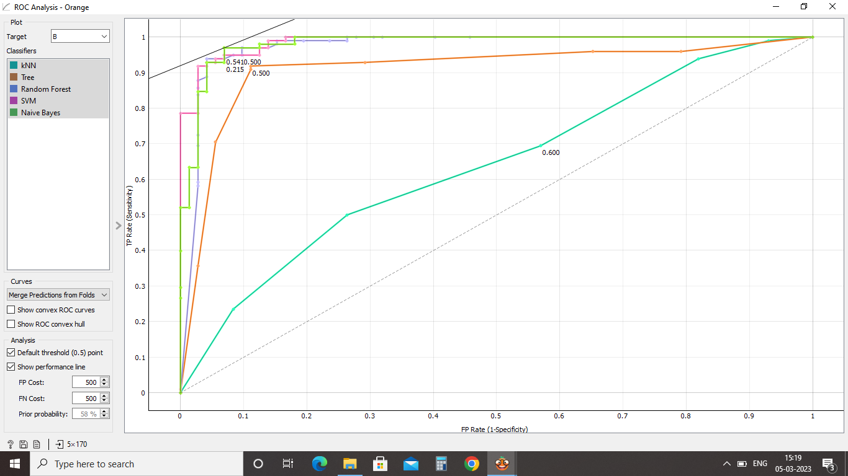

Slide 19
FUTURE SCOPE
Work with various kind of disease dataset which are larger and also fetch from different sources.
Also find new and prominent feature using feature selection.

Slide 20
REFERENCES
https://www.javatpoint.com/classification-algorithm-in-machine-learning
https://www.breastcancer.org/facts-statistics?gclid=Cj0KCQiA0oagBhDHARIsAI-BbgeqKSYb9BR1If8Amtl_CO0raZqaN6jsu6Upu18NrywSgjJI4OLN5ugaAugzEALw_wcB
https://www.slideshare.net/Mithileysh/orange-data-mining-data-visualization-tool
https://monkeylearn.com/blog/classification-algorithms/

Slide 21
THANK YOU

